Slide 1
Shiny QC

Slide 2
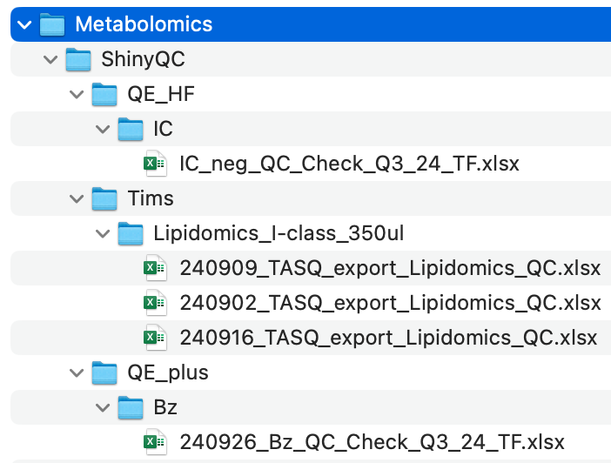
Where and what to store
Proposed directory structure on octopus:
Format either:
Bruker output
Tracefinder output (does not need to go through converter)
Other formats on request

Slide 3
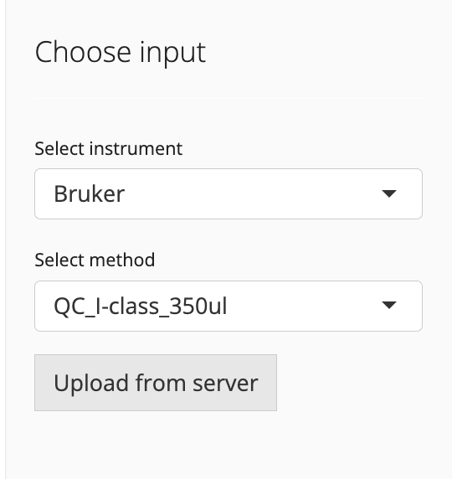
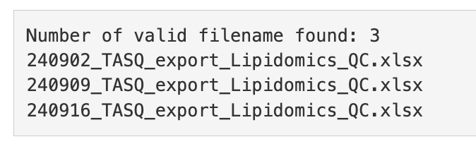
Select instrument and method
All .xlsx files in that directory will be read and concatenated

Slide 4
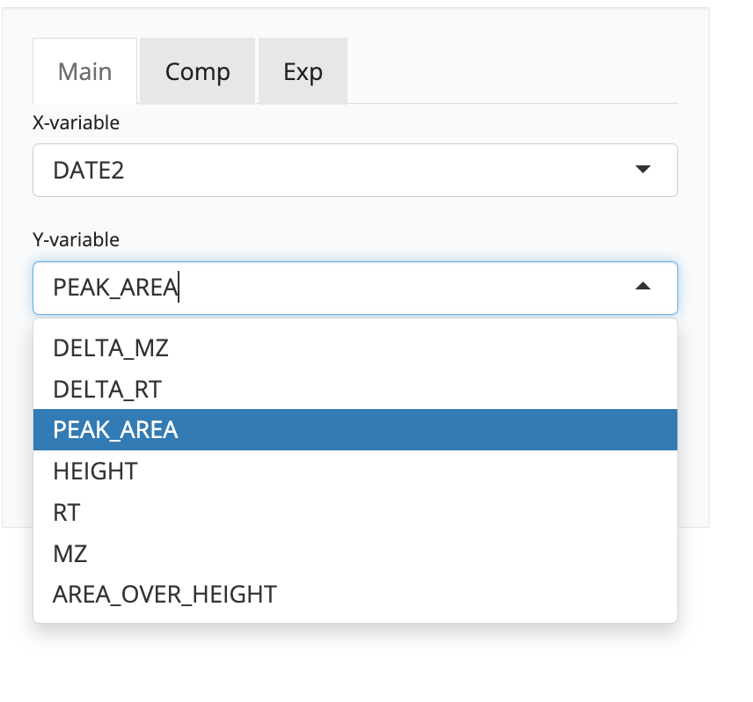
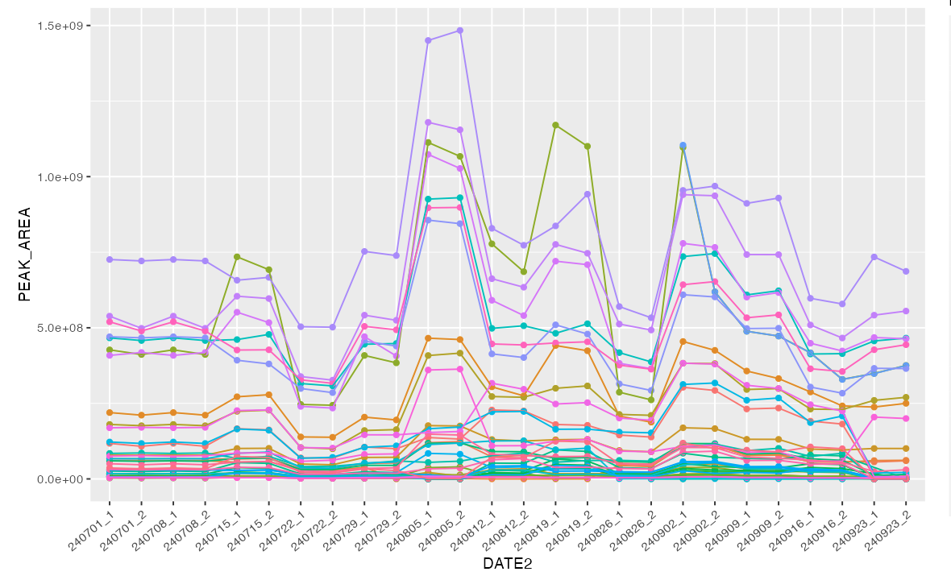
Plotting
Choose what to plot

Slide 5
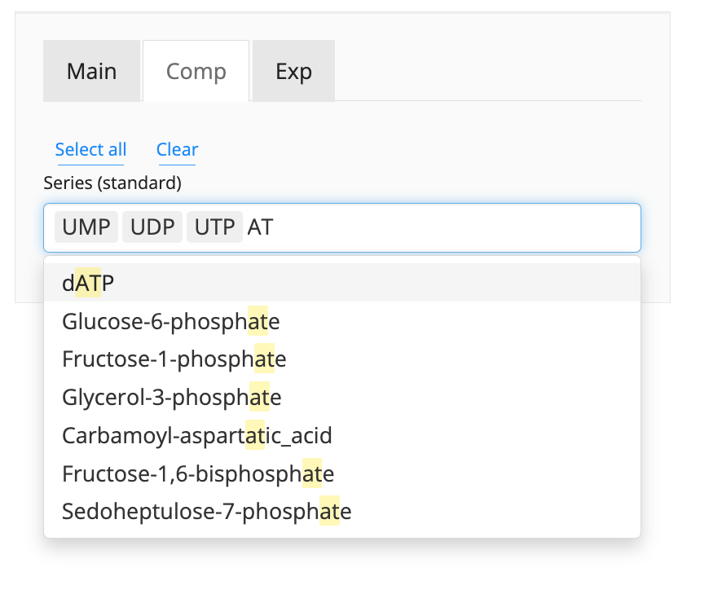
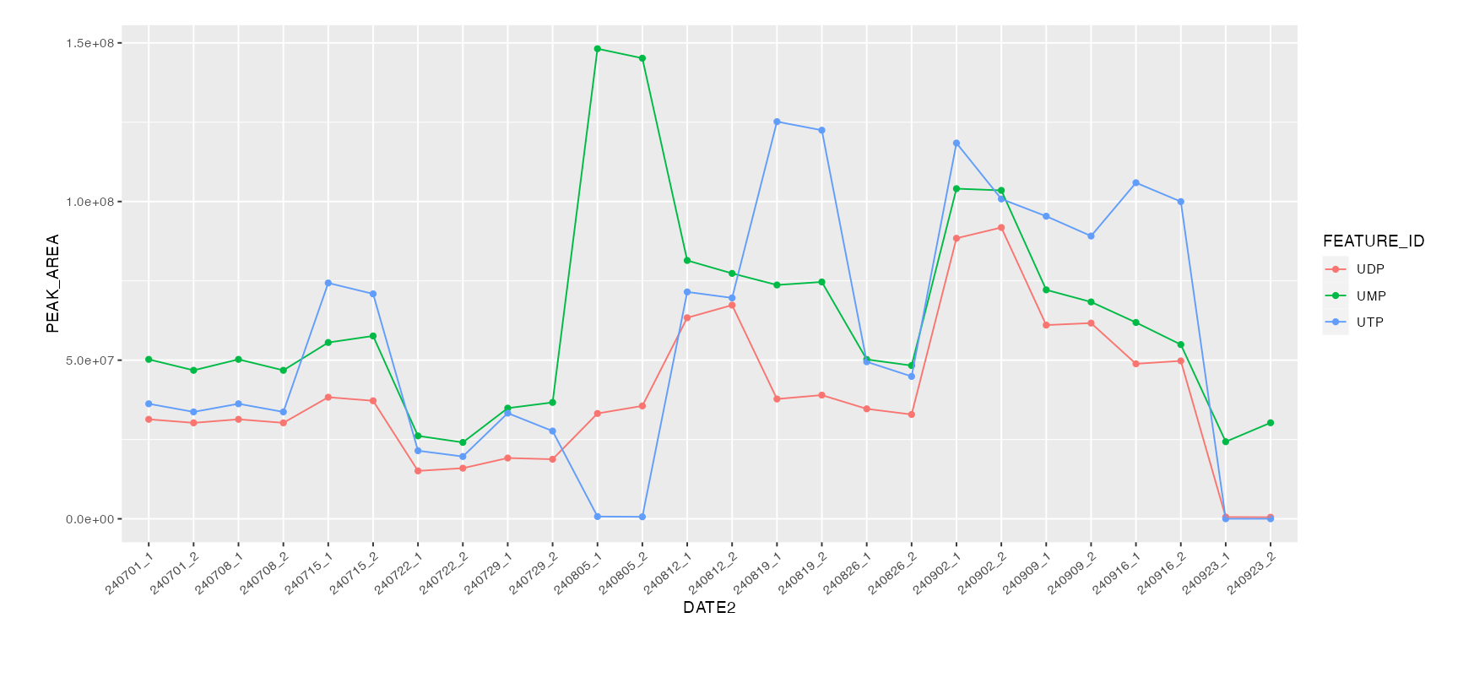
Selecting compounds

Slide 6
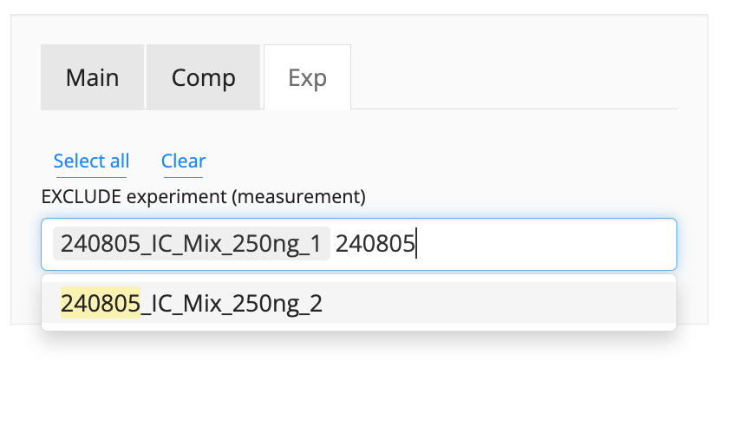
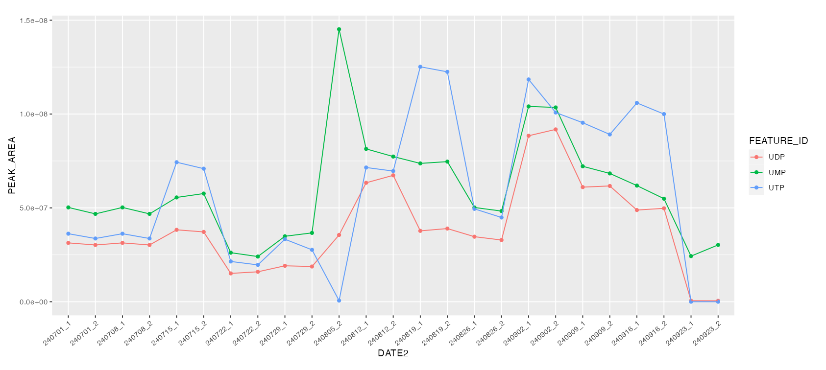
Excluding experiments

